Slide 1

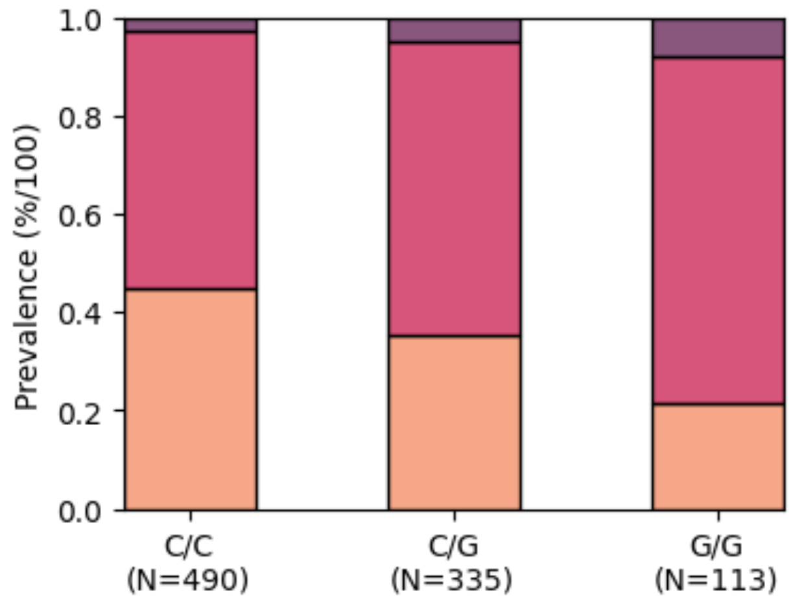
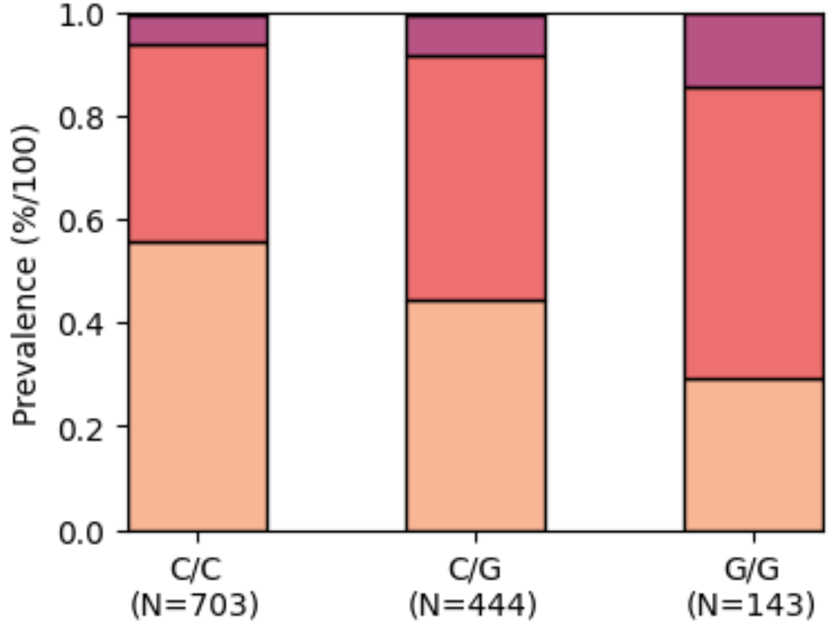
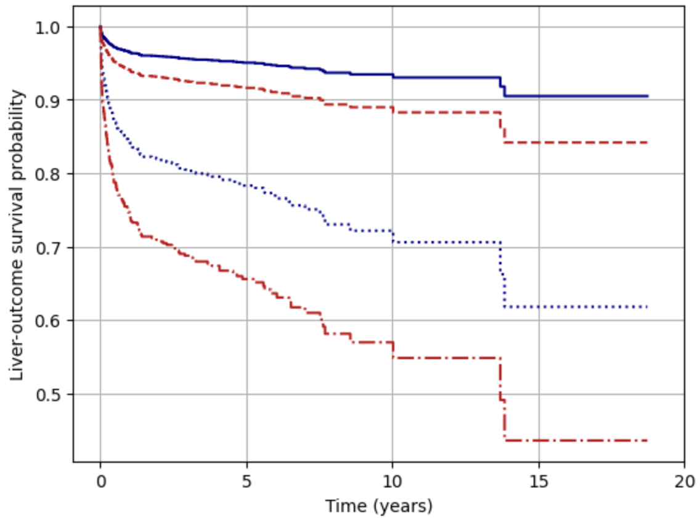

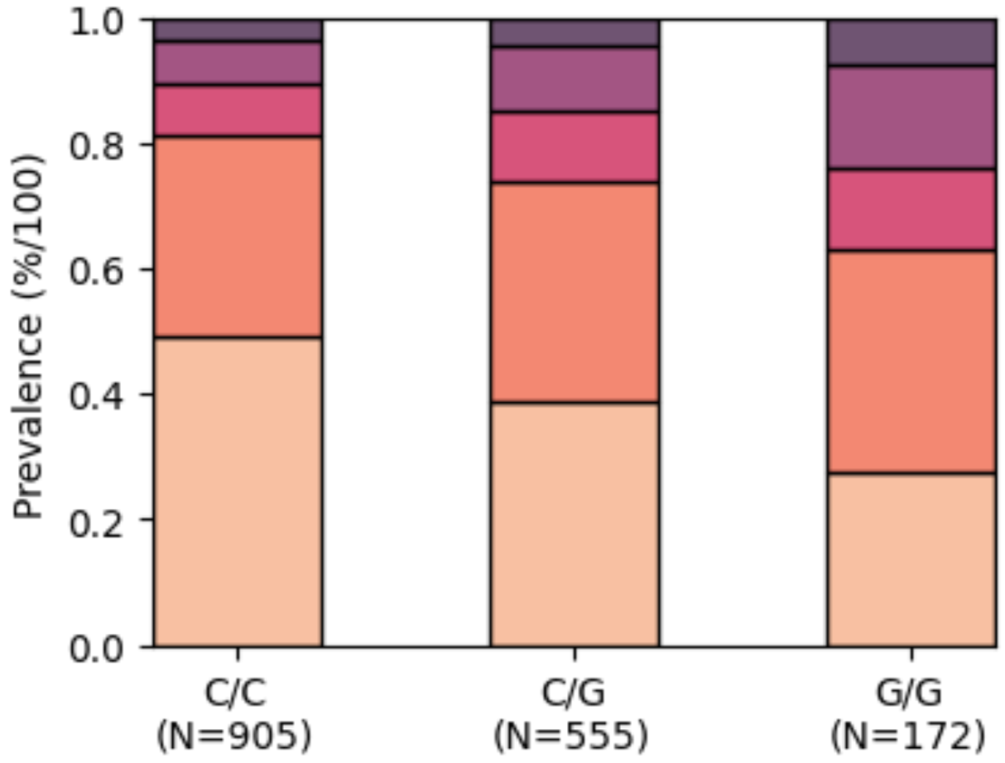
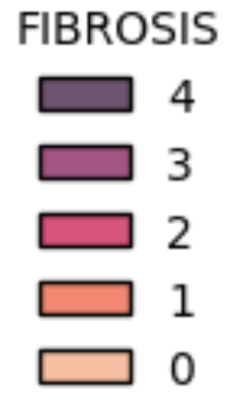
F0-F1
#416
Patatin-like phospholipase domain-containing 3 (PNPLA3) risk allele increases rate of progression to end-stage liver disease outcomes and decreases survival rate over time irrespective of degree of fibrosis
Liver outcome-free probability
F2-F4
Time (years)
Javier Armisen¹, Nellie Fernando², Monika Huhn³, Mitra Rauschecker ⁴, Linda Wernevik⁵, Ola Fjellström⁵, Dirk Paul​⁶, Björn Carlsson⁵​, Nils Svangård³, Jenny E. Blau⁴
1 Early Development, Cardiovascular, Renal and Metabolism, BioPharmaceuticals, R&D, AstraZeneca, Cambridge, UK ; 2 AI & Advanced Analytics, Data Science & Artificial Intelligence, R&D, AstraZeneca, Cambridge, UK; AI & Advanced Analytics, Data Science & Artificial Intelligence, R&D, AstraZeneca, Gothenburg, Sweden; 4 Early Development, Cardiovascular, Renal and Metabolism, BioPharmaceuticals, R&D, AstraZeneca, Gaithersburg, US; 5 Early Development, Cardiovascular, Renal and Metabolism, BioPharmaceuticals, R&D, AstraZeneca, Gothenburg, Sweden; 6 Centre for Genomics Research, Discovery Sciences, R&D, AstraZeneca, Melbourn Science Park, UK
Introduction
Results
The severity of hepatic fibrosis is the most important predictor of liver-related mortality ⁽¹⁾
The strongest genetic risk factor is a single-nucleotide polymorphism (rs738409) in the PNPLA3 gene I148M ⁽²⁾
The 148M allele has been associated with increased hepatic triglyceride accumulation, liver injury and fibrosis.
PNPLA3 G/G genotype carries display significantly (p=4e-04) more severe disease as measured by higher score in steatosis, ballooning, inflammation
PNPLA3 G/G risk allele increases risk of end-stage liver disease (ESLD) outcomes irrespectively of degree of fibrosis
Ballooning
Inflammation
C/C
F0-F1
Aim
G/G
To evaluate the characteristics and progression rates to outcomes among PNPLA3 G/G and C/G risk allele carriers as compared to non-risk allele carriers (C/C) utilizing the well-characterized longitudinal biopsy-confirmed NAShBio cohort.
Liver outcome-free probability
C/C
Methods
A Cox proportional hazards model was used to determine the effect of the PNPLA3 risk allele G/G (148MM) on liver outcomes including cirrhosis, HCC and transplant as compared with C/G (148IM) and C/C (148II). Survival analysis was performed with adjustments for confounders including age, BMI, gender, T2DM, and fibrosis stage, censored at study drop out or death.
G/G
F2-F4
 | C/C | C/G | G/G
NAS Score (mode) p=2.2e-12 | 1 | 2 | 4
Time (years)
Cohort Demographics
ESLD outcome-free probability rate from date of biopsy, adjusted for gender, BMI, age, T2DM, and fibrosis; p=0.05. Liver outcomes defined as: cirrhosis; decompensated cirrhosis; hepatocellular carcinoma; liver failure & transplantation.
Nashville Bioscience Adult Cohort | NAFLD & NASH | NASH confirmed biopsy
Number of patients | 1686 | 762
Male sex – no.(%) | 495 (29%) | 239 (31%)
Hispanic or Latino | 37 (2%) | 16 (2%)
Age at diagnosis (years) | 48 [18-83] | 48 [18-83]
BMI | 42.3 [15.6-94.23] Q₁=36, Q₃=49.6 | 42.3 [17.5-94.23] Q₁=35.9, Q₃=49.6
Type 2 diabetes– yes (%) | 660 (39%) | 373 (49%)
ALT (U/l) | 29 [5-948] Q₁=20, Q₃=51 | 36 [5-682] Q₁=24, Q₃=61
AST (U/l) | 26 [6-4174] Q₁=20, Q₃=40 | 32 [11-375] Q₁=23, Q₃=52
PNPLA3 genotype
G/G | 142 (9%) | 99 (14%)
C/G | 534 (34%) | 269 (38%)
Steatosis
Grade 0 – no.(%) | 162 (10%) | 8 (1%)
Grade 1 – no.(%) | 937 (56%) | 347 (46%)
Grade 2 – no.(%) | 399 (24%) | 257 (34%)
Grade 3 – no.(%) | 188 (11%) | 150 (20%)
Fibrosis
Stage 0 | 724 (44%) | 322 (43%)
Stage 1 | 553 (34%) | 135 (18%)
Stage 2 | 150 (9%) | 128 (17%)
Stage 3 | 144 (9%) | 94 (12%)
Stage 4 | 76 (5%) | 76 (10%)
NASH PNPLA3 G/G genotype carriers have a significant higher liver enzymes adjusted for gender, age, T2DM status and degree of fibrosis:
ALT, p=0.00094
AST, p=0.0095
Ordinal regression of NAS components, adjusted for age, T2DM, gender, BMI and fibrosis
Key take away messages
PNPLA3 G/G genotype carriers are predominantly associated with more severe fibrosis stage, p=4.5e-09
Biopsy-confirmed NASH homozygous PNPLA3 G/G risk allele carriers progress to liver-related outcomes significantly faster than PNPLA3 C/G and C/C genotypes carriers, adjusted for age, gender, BMI, diabetes status, and fibrosis stage.
References
Angulo et al Gastroenterology, 2015
Romeo et al Nat Genet, 2008.
Acknowledgements
Jeanna Sundelin, Mathias Liljeblad, Mohammad Niaz, Janeli Sarv, Oskar Clewe, Olof Eklund, Richard Torstenson, Angela Coggi, Nashville Bioscience
Presented at the International Liver Congress™ 2023, Vienna, Austria, 21-24 June 2023
Notes:
p=3.6e-08

